Slide 1


Malicious URL Detection using Machine Learning
By
Student Name Academic ID
Hailah Alharthi 445306944
Supervisor: Dr.Turki Alalyani

Slide 2
Research Story
One of the most important decisions that must be made quickly is whether to click on a link. Once, I received an email that seemed convincing enough to make me click on the link and view its content to help my manager complete a task for a client. The email arrived at the end of the week, and I was eager to finish the task. I clicked on the link and started trying to access the files.
Thankfully, it turned out to be a simulated phishing attempt. It was very effective, and it taught me to always check for phishing indicators and examine links carefully before clicking on them.
However, there are many people whose work requires accessing links, and they may sometimes neglect to check them thoroughly. This is why the idea of using machine learning techniques to detect malicious links emerged.

Slide 3

Agenda
Introduction
Literature Review
Research Methodology
Experiments Results
Summary & future work

Slide 4
Introduction
In today's rapidly evolving technological landscape, organizations face significant risks from cybersecurity threats, specially phishing attacks. Our research aims to investigate innovative methods for analyzing URLs to detect and minimize the impact of these threats, leveraging the power of machine learning to improve security measures and protect organizations against phishing attacks
2024
Malicious URL Detection using Machine Learning
4

Slide 5

Background on Phishing Attacks
1
What is Phishing?
Phishing is a type of cyberattack where attackers use social engineering tactics to trick victims into revealing sensitive information or performing actions that compromise security.
2
Phishing Techniques
Phishing attacks can be carried out through various methods, including
email, website, and
social media-based techniques,
all aimed at gaining initial access to the victim.
3
Evolving Threat Landscape
As cybersecurity measures improve, threat actors continuously adapt their techniques, making it crucial to explore new detection methods to stay ahead of the curve.

Slide 6
Literature Review
We reviewed 31 research papers;
25 included experiments on detection techniques,
5 were literature reviews and
one was an experiment to evaluate social awareness about phishing.
The result show that using machine learning seems promising where it registers accuracy scores from 0.88 till 1.00 which means that we can eliminate the risk of phishing URLs by employing machine learning .
However the used dataset was limited to specific area which may lead to unreliable result in some studies. In our research we will examine machine learning capabilities to detect malicious URLs on recent dataset contain malicious and legit URLs then we will evaluate the result.

Slide 7
Research Objective
This research aims to evaluate Machine learning algorithms capabilities in detecting malicious URLs, this will give us more insight on the effectiveness of using machine learning algorithm to detect malicious URLs.
Research question
We will do an experiment to answer the following question :
Can machine learning algorithms detect malicious URLs with high accuracy and low error rates?
What algorithm has the highest accuracy among ML algorithms ?

Slide 8

Methodology
In this research we will go through the following stages:
Collecting Dataset From Public Resources
Exploring And Validate The Collected Dataset
Cleaning The Collected Dataset
Analysing The Dataset
Splitting The Collected Dataset To Apply ML Algorithms
Apply ML Algorithms
Evaluate The Used Algorithms

Slide 9
Experiments Results
Experience One
Experience Tow
Experience Three
Experience Four
Experience five
In the first experiment, we went through the entire dataset, cleaning and analyzing it, and we applied stacking techniques. However, we faced an overfitting issue, consistently achieving 100% accuracy.
In the second experiment, we tried applying a single algorithm, but the same issue occurred and we got 100% accuracy.
In the third experiment, we attempted to reduce the number of non-malicious sites in the dataset to determine if the problem was related to the dataset itself. Unfortunately, we faced the same issue again and decided to try another dataset.
In the fourth experiment we extract dataset from Phishtank and search for dataset contain trustful URLs and we got Alexa dataset the we prepare the dataset and use Random forest algorithm and we got 82%
On the same dataset we try apply stacked algorithms and we got 90%. Then we apply grid search to find out the best parameter and we may reach 92 % once we use them

Slide 10
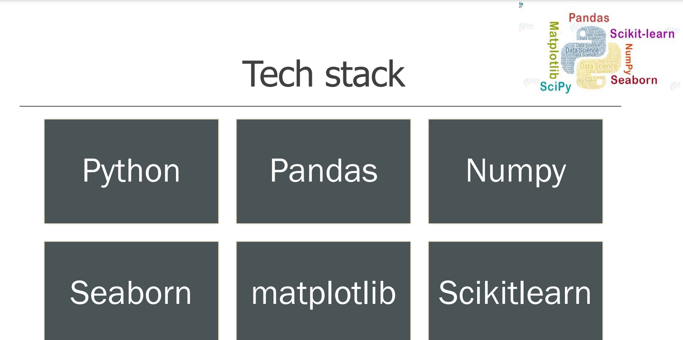
Tools & Technologies

Slide 11

Summary & Future work
In conclusion, this study focuses on
utilizing machine learning algorithms to detect malicious URLs.
We began by conducting a literature review of 31 papers to understand the state of the art.
We collected datasets from various resources and proceeded to analyze them.
During this process, we encountered challenges in finding the most suitable dataset, which ultimately enhanced the reliability of our research.
We conducted three failed experiments before achieving success with two experiments, where we attained accuracy scores ranging from 80% to an optimized 93%. Moving forward,
we intend to expand the dataset further and explore different scenarios to determine the potential accuracy scores.

